Slide 1

Basic CRUD
ORM, Entity Framework and CRUD
SoftUni Team
Technical Trainers
Software University
http://softuni.bg

Slide 2
Table of Contents
Object-Relational Mapping (ORM)
Entity Framework Core
Basic CRUD
Create
Read
Update
Delete

Slide 3
Have a Question?
sli.do
#tech-fund

Slide 4

Object-Relational Mapping
ORM Concepts and Features

Slide 5

ORM Overview
ORM Frameworks maps model classes to database tables
Model
class
Mapping Logic
Object in Memory
Relational Database

Slide 6
ORM Frameworks - Features
C# Entity classes are mapped to DB tables
ORM provides API for CRUD operations
List objects / query database
Create new object
Update existing object
Delete existing object
ORM provides schema synchronization (DB migrations)
CRUD operations execute
SQL commands in the DB

Slide 7
ORM Advantages and Disadvantages
Advantages:
Developer productivity: writing less code
Abstract from differences between object and relational world
Manageability of the CRUD operations for complex relationships
Easier maintainability
Disadvantages:
Reduced performance (due to overhead or auto generated SQL)
Reduces flexibility (some operations are hard to implement)

Slide 8

Entity Framework Core
Powerful ORM for .NET Core and ASP.NET Core MVC

Slide 9
Entity Framework Core
The standard ORM framework for .NET and .NET Core
Mapping an object-oriented model to a relational database
Provides LINQ-based data queries and CRUD operations
Using C# Annotations

Slide 10
Entity Framework Core(2)
Tables
Entity Framework
Classes
Generate Data Access Classes for Existing Database
Tables
Classes
Entity Framework
Create Database from Domain Classes

Slide 11
Entity Framework Core - Overview
Access database through DbContext with C# classes:
class BlogDbContext : DbContext
{
public DbSet<User> Users { get; set; }
public DbSet<Article> Articles { get; set; }
}
class User { Id, Username, PasswordHash, FullName, Articles }
class Article { Id, Title, Content, Date, AuthorId, Author }
var db = new BlogDbContext();
foreach (var article in db.Articles)
{
Console.WriteLine( article.Title + " " + article.Date);
}

Slide 12
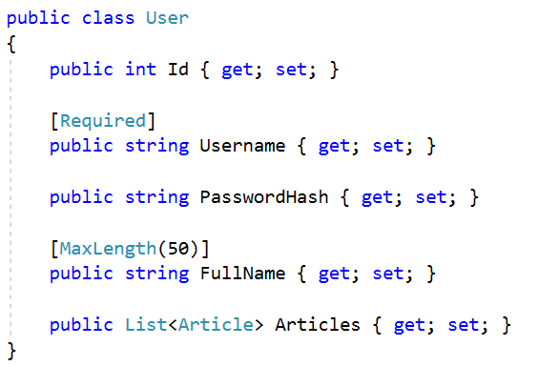
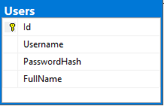
Entity Classes
Entity classes are regular C# classes
Used as models for creating Database tables

Slide 13
Data Annotations Attributes
Specifies that the property's value is required
Sets the maximum allowed length of the property value
Property is to be excluded from database mapping.
[Required]
public string Email { get; set; }
[MaxLength(50)]
public string Username { get; set; }
[NotMapped]
public List<Article> Articles { get; set; }

Slide 14
Creating Models (Entity Classes) with EF Core
EF Core uses classic C# classes
public class User
{
public int Id { get; set; }
[Required]
public string Username { get; set; }
public string PasswordHash { get; set; }
[MaxLength(50)]
public string FullName { get; set; }
public List<Article> Articles { get; set; }
}
The Id column is the primary key
[Required] makes the DB column non-nullable
One-to-many relationship

Slide 15
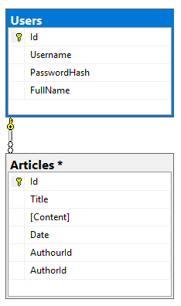
Creating Models (Entity Classes) with EF Core
public class Article
{
public int Id { get; set; }
[Required]
public string Title { get; set; }
[Required]
public string Content { get; set; }
public DateTime? Date { get; set; }
public int? AuthorId { get; set; }
public User Author { get; set; }
}
Many-to-one relationship

Slide 16
Creating the DbContext Class
Creating a DB context for the application:
Each DbSet<T> corresponds to a single database table
foreach-able
Supports LINQ operations
public class AppDbContext : DbContext
{
public DbSet<User> Users { get; set; }
public DbSet<Article> Articles { get; set; }
}
List the mapped DB tables using DbSet<Type>

Slide 17
DbContext: Accessing Table Data
Use DbContext class for accessing the database
Access through properties
var db = new AppDbContext();
foreach (var a in db.Articles)
{
Console.WriteLine($"Title: {a.Title}");
Console.WriteLine($"Content: {a.Content}");
Console.WriteLine($"Posted by: {a.Author?.FullName}");
}

Slide 18

CRUD in ASP.NET Core MVC with EFC
Manipulating Database

Slide 19
Creating Entities – Controller
Adding new element to database table:
[HttpPost]
public IActionResult CreateArticle(string title, string content)
{
var article = new Article(title, content);
using (var db = new BlogDbContext())
{
db.articles.Add(article);
db.SaveChanges();
}
return RedirectToAction("Index", "Home");
}

Slide 20
Reading Entities – Controller
We can find a single element by ID, using Find( )
Generated route: “/Article/ArticleDetails/2”
[HttpGet]
public IActionResult ArticleDetails(int id)
{
using (var db = new BlogDbContext())
{
var article = db.Articles.Find(id);
return View(article);
}
}

Slide 21
Reading Entities – Controllers (2)
We can retrieve an entire collection, using the DbContext:
Generated route: “/Article/ListArticles/”
[HttpGet]
public IActionResult ListArticles()
{
using (var db = new BlogDbContext())
{
var articles = db.Articles.ToList();
return View(articles);
}
}

Slide 22
Reading Entities – Controllers (3)
We can use LINQ on DbContext, just like a normal collection
[HttpGet]
public IActionResult ArticlesByAuthor(int authorId)
{
using (var db = new BlogDbContext())
{
var articlesByAuthor = db.Articles
.Where(article => article.Author.Id == authorId)
.ToList();
return View(articlesByAuthor);
}
}

Slide 23
Updating Entities
Editing existing entry in database:
[HttpPost]
public ActionResult Edit(int id, string title, string content)
{
using (var db = new BlogDbContext())
{
var article = db.Articles.Find(id);
article.Title = title;
article.Content = content;
db.SaveChanges();
}
return RedirectToAction("Index", "Home");
}

Slide 24
Deleting Entities
Deleting existing entry in database:
[HttpPost]
public IActionResult Delete(int id)
{
using (var db = new BlogDbContext())
{
var article = db.Articles.Find(id);
db.Articles.Remove(article);
db.SaveChanges();
}
return RedirectToAction("Index", "Home");
}

Slide 25

Summary
…
…
…
Object-Relational Mapping
Entity Framework Core
Entity Classes
DbContext, DbSet<T>
CRUD Operations
Create, Read, Update, Delete

Slide 26
https://softuni.bg/courses/technology-fundamentals

Slide 27













SoftUni Diamond Partners

Slide 28





SoftUni Organizational Partners

Slide 29




Trainings @ Software University (SoftUni)
Software University – High-Quality Education and Employment Opportunities
softuni.bg
Software University Foundation
http://softuni.foundation/
Software University @ Facebook
facebook.com/SoftwareUniversity
Software University Forums
forum.softuni.bg

Slide 30

License
This course (slides, examples, demos, videos, homework, etc.) is licensed under the "Creative Commons Attribution-NonCommercial-ShareAlike 4.0 International" license

